Slide 1
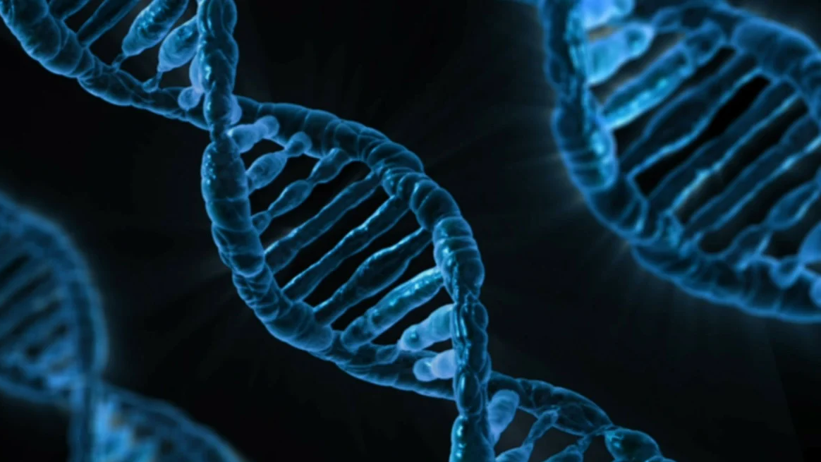
Genetic Algorithm
Minqi Xu
20845758
m259xu@uwaterloo.ca

Slide 2
Natural Selection
Proposed by Charles Darwin in 1859
Variation is the result of genetic difference which can arise through mutation or genetic recombination.
Offspring inherit traits from parents.
Overproduction.
Environment is challenging.
Survival of the fittest (Advantageous traits are more likely to pass to the next generation).
Frequency of advantageous traits increases in the population.

Slide 3
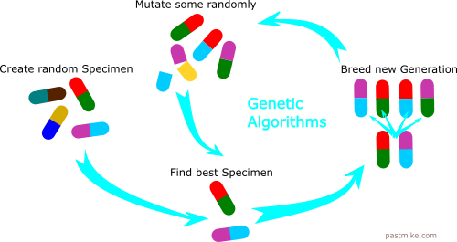
Connections

Slide 4
Travelling Salesman Problem(TSP)
Given a list of cities and the distance between each pair of cities, what is the shortest possible route that visits each city exactly once and returns to the origin city?
NP-hard (No efficient solution)

Slide 5
Terminology
Gene – a city (vertex)
Individual (a.k.a. “chromosome”) - single walk satisfied the condition
Parents - two individuals that will combine to produce new individual
Mating Pool – collection of parents
Fitness – a function that tells us how good the individual is
Elitism – carry best individuals to the next generation (for quicker convergence)

Slide 6
Initiation
Import data
Randomly generate individuals
Generate initial generation
Determine the fitness

Slide 7
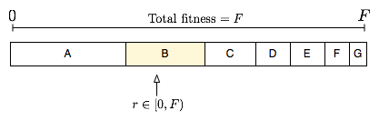
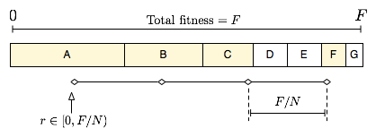
Selection
Sort based on fitness
Using selection method to select the high-fitness individual
Fitness proportionate selection (roulette wheel selection)
Stochastic universal sampling

Slide 8
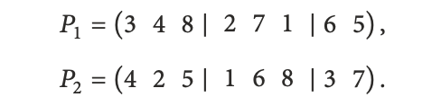
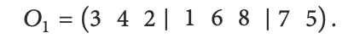
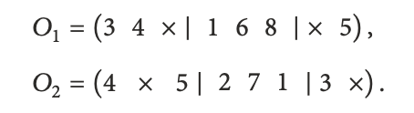
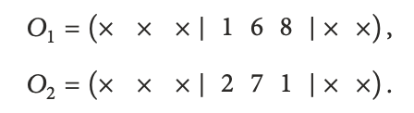
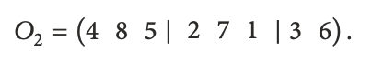
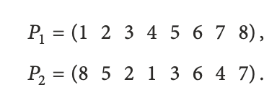
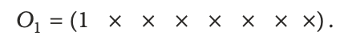
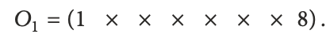
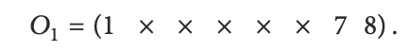
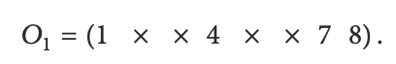
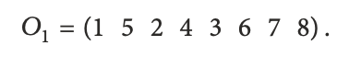
Crossover
Partially Mapped Crossover
Cycle Crossover

Slide 9
Mutation
Mutation Rate
Test for each vertex in the walk
If test pass, randomly select a vertex in the walk and swap
Individual (walk)
Traversing every vertex
If test pass, randomly
select another vertex,
then swap

Slide 10
Dataset from https://www.math.uwaterloo.ca/tsp/world/countries.html
GA with population_size=100,elite_size=20,mutation_rate=0.01
number_of_generation=5000
Known that the optimal walk is of length 6656

Slide 11
Reference
https://pixabay.com/illustrations/dna-biology-medicine-gene-163466/
https://pastmike.com/what-is-a-genetic-algorithm/
https://commons.wikimedia.org/wiki/File:Fitness_proportionate_selection_example.png
https://commons.wikimedia.org/wiki/File:Statistically_Uniform.png
Hussain A, Muhammad YS, Nauman Sajid M, Hussain I, Mohamd Shoukry A, Gani S. Genetic Algorithm for Traveling Salesman Problem with Modified Cycle Crossover Operator. Computational intelligence and neuroscience.2017;2017:7430125-7430127.doi:10.1155/2017/7430125

